Slide 1
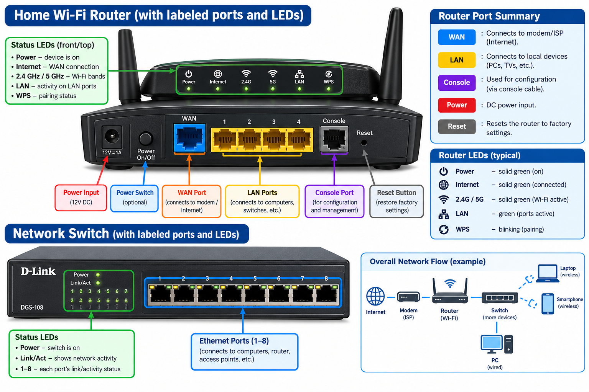
Labeled Diagram of a Home Wi-Fi Router and Network Switch

Slide 2
WAN Port: Connects the router to the incoming internet source (modem or ISP line).
LAN Ports (1–4): Used to connect local wired client devices (like desktop PCs or switches).
Console Port: Used by network administrators for direct CLI (Command Line Interface) configuration and troubleshooting.
Status LEDs: Indicate system power, Wi-Fi broadcast status, internet connectivity, and individual link/activity status for each port.

Slide 3
Key Differences Between Routers and Switches
Feature / Criteria | Router | Switch
1. OSI Layer & Network Scope | Operates at Layer 3 (Network Layer). It connects distinct and separate networks together (e.g., connecting a home/office LAN to the wide-area Internet). | Operates at Layer 2 (Data Link Layer). It connects multiple devices together to form a single Local Area Network (LAN).
2. Addressing & Data Handling | Uses IP Addresses (Logical Addressing) to determine the best path to forward data packets across different networks. | Uses MAC Addresses (Physical Addressing) contained in data frames to forward traffic directly to the specific target port within the local network.
3. Primary Function & Traffic Flow | Acts as a traffic coordinator between different networks, providing Network Address Translation (NAT), DHCP services, and firewall security. | Acts as a high-speed internal bridge, routing data frames strictly between connected devices within the same network segment using unicast forwarding.

Slide 4
Port and LED Identification (Router & Switch Descriptions)
1. Router Components
Power Port (DC IN): A circular socket where the external 12V power adapter plugs in to supply electrical power to the device.
Ethernet Ports (WAN & LAN): RJ-45 modular jack connectors. The WAN port receives broadband data, while LAN ports distribute local data signals over copper twisted-pair cables.
LED Indicators:
  Power LED: Glows solid green or white to indicate the device is powered on.
  Internet/WAN LED: Blinks or turns solid when actively communicating with the ISP.
  LAN LEDs: Flash rapidly when data is actively transmitting between connected wired devices.
2. Switch Components
Power Port: Standard AC socket or DC barrel jack depending on whether it is an unmanaged desktop switch or a rack-mounted enterprise switch.
Ethernet Ports: Multiple RJ-45 female ports arranged in a row (e.g., 5, 8, or 24 ports) to plug in network cables from computers, printers, and routers.
LED Indicators:
  Power LED: Indicates active power supply to the switch logic board.
  Link/Activity (LNK/ACT) LEDs: Each port has a dedicated LED that lights up when a cable is securely plugged in and flashes whenever data packets pass through that specific port.

Slide 5
Gaming Cafe Network Setup Scenario (IPL Streaming & Multiplayer)
Device Connection Order
Connect the Router First: The incoming ISP line (fiber/broadband) must connect directly to the WAN port of the Router.
  Justification: The router acts as the primary gateway. It handles public-to-private IP translation via NAT (Network Address Translation), runs the DHCP server to assign local IP addresses, and provides essential firewall protection against external threats.
Connecting the 8 Gaming PCs
Run an Ethernet cable from one of the LAN ports on the Router to an uplink port on an 8-port (or higher) Gigabit Network Switch.
Connect each of the 8 gaming PCs using high-quality Cat6 Ethernet cables directly into the individual RJ-45 ports on the Network Switch.
Comprehensive Justification
Bandwidth & Latency Control: Multiplayer competitive gaming and live 4K IPL streaming require ultra-low latency and zero packet loss. Wi-Fi is susceptible to interference and congestion, making wired Ethernet via a switch essential.
Port Expansion: A standard consumer or small business router typically only features 4 LAN ports. Introducing a network switch expands the available wired ports effortlessly to accommodate all 8 gaming PCs plus any auxiliary streaming or billing terminals without bottlenecks.

